Slide 1
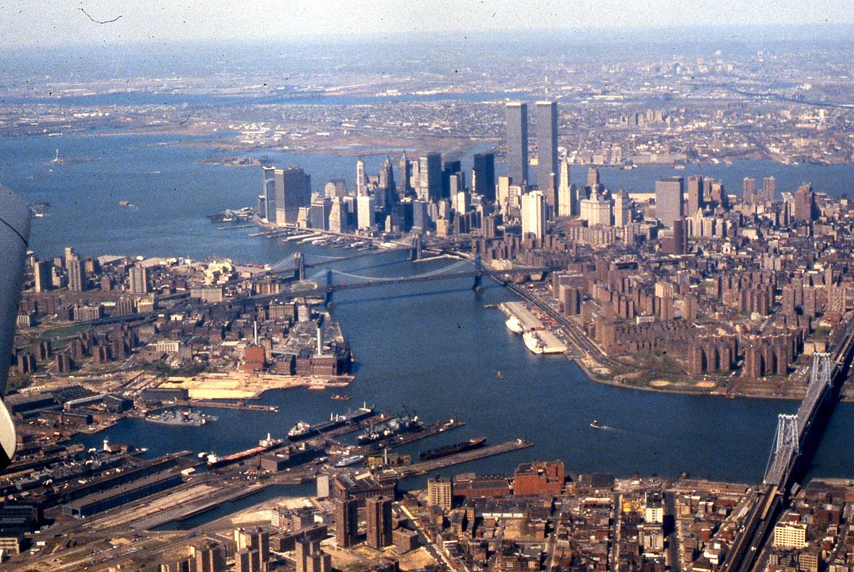
The battle of neighbourhoods
New York city market analysis

Slide 2
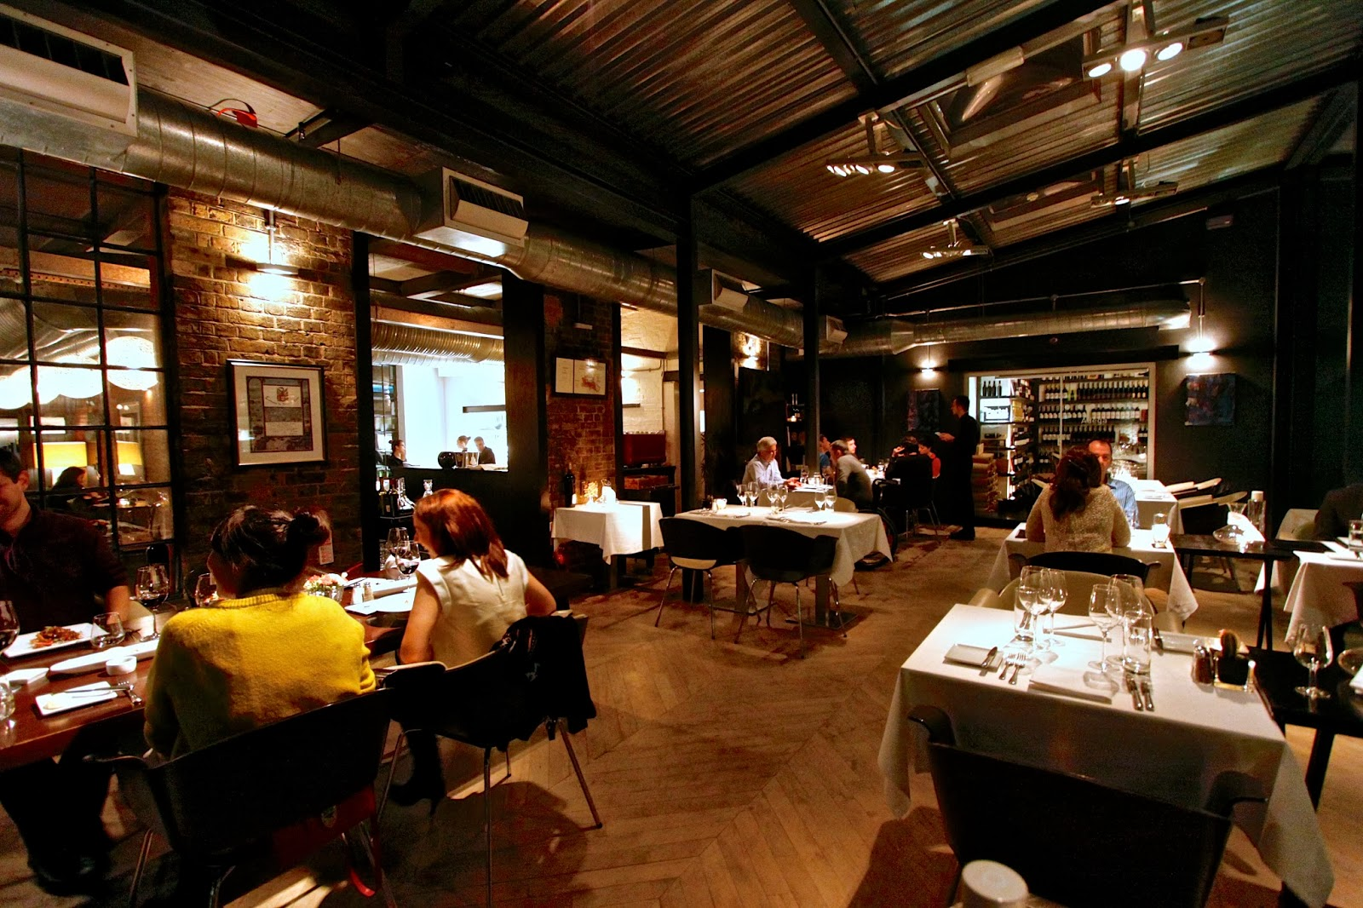
INTRODUCTION & BUSINESS PROBLEM
MARKET REVIEW OF NEW YORK CITY FOR A NEW RETAURANT VENTURE
New York city has been chosen for this analysis as the city is a global hub for business and commerce
Populous city in the united states with an estimated 8,398,748 residents as of July 2018
Multi cultural and offers business friendly environment
BUSINESS PROBLEM
Identifying an optimum location to start a new restaurant venture in one of the 306 new York neighbourhoods
Location and cuisine must have high demand and cost effective to replicate
Great menu that can sustain the competition

Slide 3


NEW YORK CITY CUISINES
The City of New York is famous for its excellent cuisine. Its food culture includes an array of international cuisines influenced by the city's immigrant history.
Central and Eastern European immigrants, especially Jewish immigrants - bagels, cheesecake, hot dogs, knishes, and delicatessens
Italian immigrants - New York-style pizza and Italian cuisine
Jewish immigrants and Irish immigrants - pastrami and corned beef
Chinese and other Asian restaurants, sandwich joints, trattorias, diners, and coffeehouses are ubiquitous throughout the city
mobile food vendors - Some 4,000 licensed by the city
Middle Eastern foods such as falafel and kebabs examples of modern New York street food
It is famous for not just Pizzerias, Cafe's but also for fine dining Michelin starred restaurants.

Slide 4

FACTORS THAT CAN INFLUENCE THE DECISION
In order to survive in such competitive market, it is very important to strategically plan. Restaurant business depends on various factors as listed below, hence these needs to be studied in order to decide on the best possible location to start a first venture:
Population
Demographics
Location of the Whole sale markets (Ex: Meat, Vegetables etc.) so that ingredients can be purchased fresh to maintain quality and cost?
Nearby Venues in the Neighbourhoods of the borough
competitors in that location?
Cuisine served by the competitors
Segmentation of the Borough
Market information (Untapped / Tapped)

Slide 5
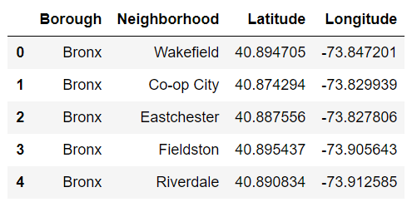
DATA SETS USED FOR THE ANALYSIS
Dataset1: Neighborhood has a total of 5 boroughs and 306 neighbourhoods. In order to segment the neighbourhoods and explore them, we will essentially need a dataset that contains the 5 boroughs and the neighbourhoods that exist in each borough as well as the latitude and longitude coordinates of each neighborhood. This dataset has been sourced from the following Link.
Link to the dataset: https://geo.nyu.edu/catalog/nyu_2451_34572

Slide 6
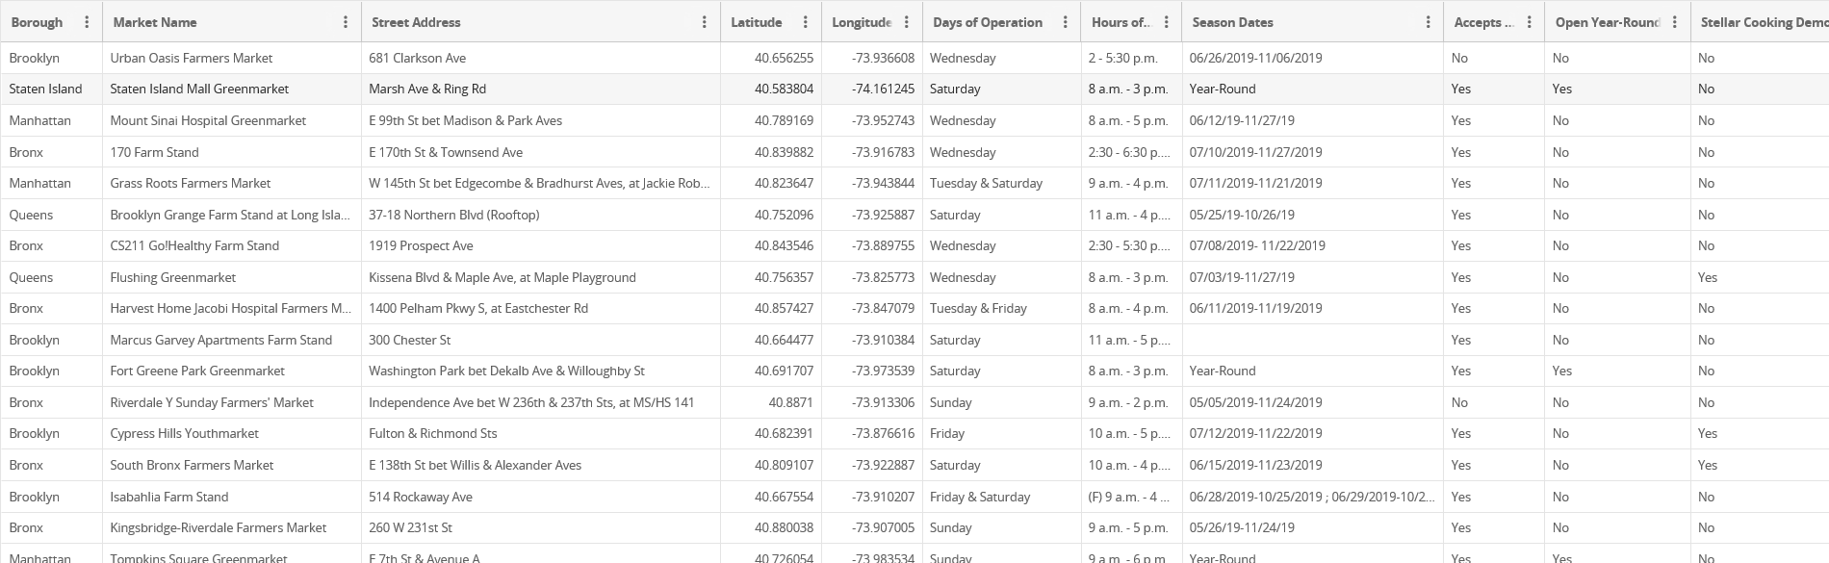
DATA SETS USED FOR THE ANALYSIS
Dataset2: Second data which will be used is the DOHMH Farmers Markets dataset. In this we will be using the data of Farmers Markets.
https://data.cityofnewyork.us/dataset/DOHMH-Farmers-Markets/8vwk-6iz2

Slide 7
DATA SETS USED FOR THE ANALYSIS
Dataset3: Data from Wikipedia links mentioned sourced to gather the information on the below:
Population
Demographics
Cuisine of New York city
List of Michelin Stared Restaurants in the city
https://en.wikipedia.org/wiki/New_York_City
https://en.wikipedia.org/wiki/Economy_of_New_York_City
https://en.wikipedia.org/wiki/Portal:New_York_City
https://en.wikipedia.org/wiki/Cuisine_of_New_York_City
https://en.wikipedia.org/wiki/List_of_Michelin_starred_restaurants_in_New_York_City

Slide 8
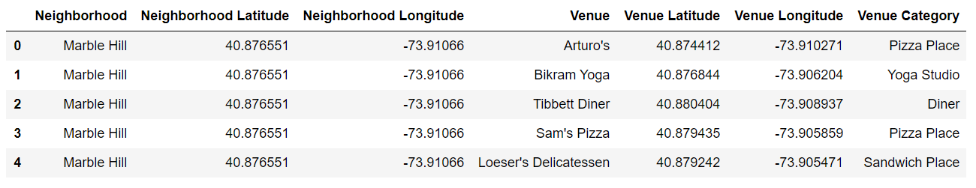
DATA SETS USED FOR THE ANALYSIS
Dataset4: A data set will be constructed by using Foursquare API. New York city geographical coordinates data will be used as an input to secure the venues information for each neighborhood of the Boroughs. This dataset then will be further segmented and clustered for analysis by using Machine learning algorithms.
Foursquare API URL = https://api.foursquare.com/v2/venues/explore

Slide 9
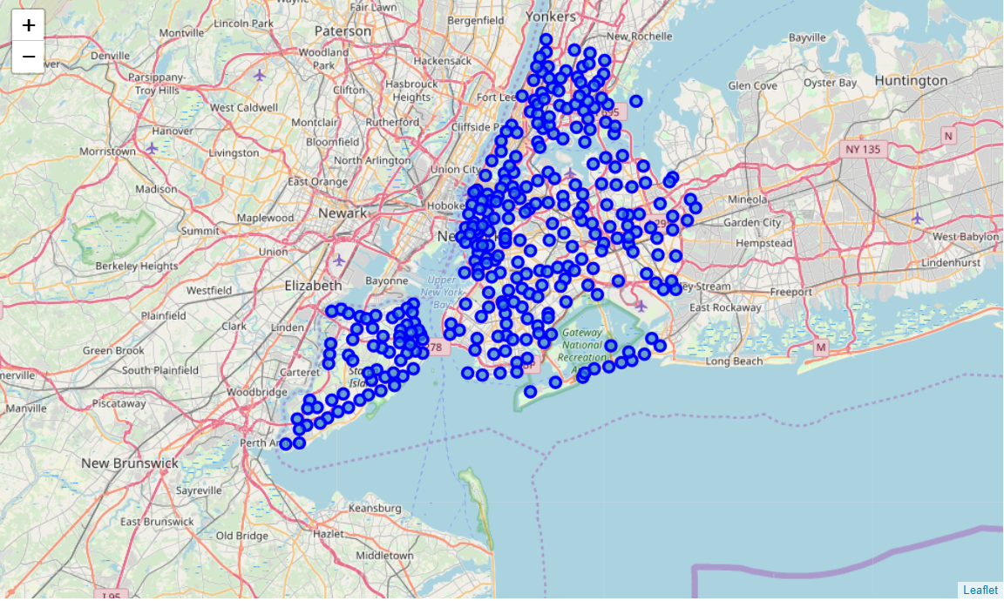
METHODOLOGY - GEOGRAPHICAL CO-ORDINATES OF NEW YORK CITY
Data for the data set has been sourced from https://geo.nyu.edu/catalog/nyu_2451_34572 to form a newyork_data.json file.
The next task is essentially transforming this data of nested Python dictionaries into a pandas data frame(neighbourhoods).
The data frame has 5 boroughs and 306 neighbourhoods and contains geographical coordinates of all the neighbourhoods of New York city boroughs
Once this data is ready, with the help of folium library a map has been created by super imposing the neighbourhoods on the New York city map

Slide 10
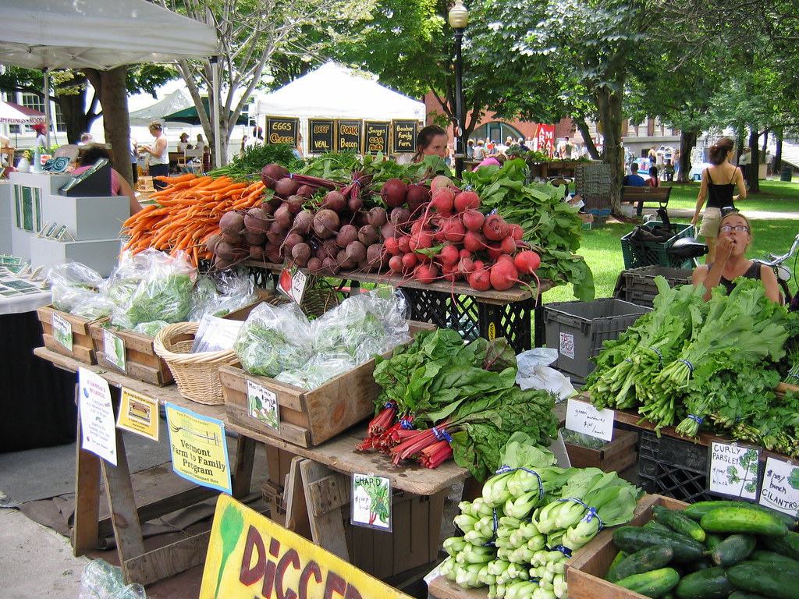
METHODOLOGY – FARMERS MARKETS OF NEW YORK CITY
DOHMH Farmers Markets dataset. In this we will be using the data of Farmers Markets. https://data.cityofnewyork.us/dataset/DOHMH-Farmers-Markets/8vwk-6iz2
After analysis the farmers market, it was observed that both Manhattan and Brooklyn have highest concentration of these markets.
Lowest number of Farmers market are in Staten Island

Slide 11
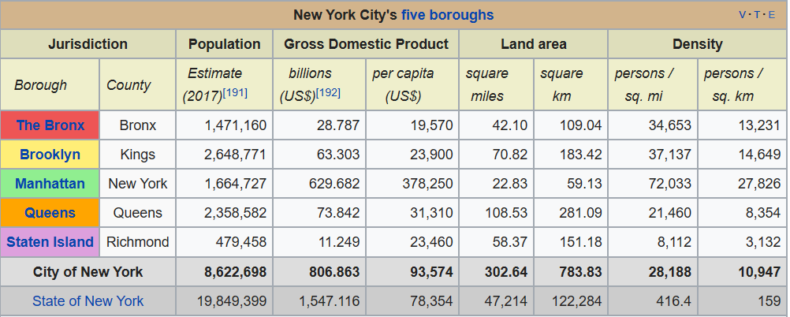
METHODOLOGY – POPULATION DENSITY NEW YORK CITY
New York City is the most populous city in the United States, with an estimated 8,398,748 residents as of July 2018. In 2017, the city had an estimated population density of 28,491 inhabitants per square mile (11,000/km²)
Manhattan (New York County) is the geographically smallest and most densely populated borough.
Brooklyn (Kings County), on the western tip of Long Island, is the city's most populous borough
Queens (Queens County), on Long Island north and east of Brooklyn, is geographically the largest borough, the most ethnically diverse county in the United States

Slide 12
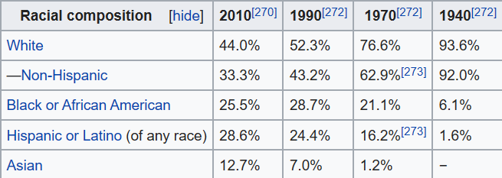
METHODOLOGY – DEMOGRAPHICS OF NEW YORK CITY
New York City is the most populous city in the United States, with an estimated 8,398,748 residents as of July 2018, incorporating more immigration into the city than outmigration since the 2010 United States Census. More than twice as many people live in New York City as compared to Los Angeles, the second-most populous U.S. city, and within a smaller area.
New York City gained more residents between April 2010 and July 2014 (316,000) than any other U.S. city. New York City's population is about 43% of New York State's population and about 36% of the population of the New York metropolitan area.

Slide 13
METHODOLOGY – DEMOGRAPHICS OF NEW YORK CITY
New York City is the most populous city in the United States, with an estimated 8,398,748 residents as of July 2018, incorporating more immigration into the city than outmigration since the 2010 United States Census. More than twice as many people live in New York City as compared to Los Angeles, the second-most populous U.S. city, and within a smaller area.
New York City gained more residents between April 2010 and July 2014 (316,000) than any other U.S. city. New York City's population is about 43% of New York State's population and about 36% of the population of the New York metropolitan area.

Slide 14
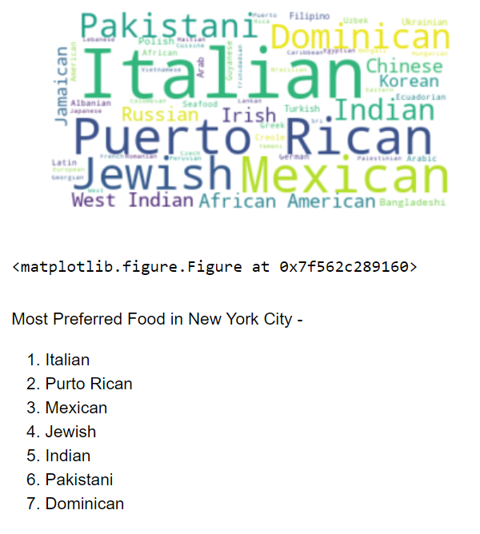
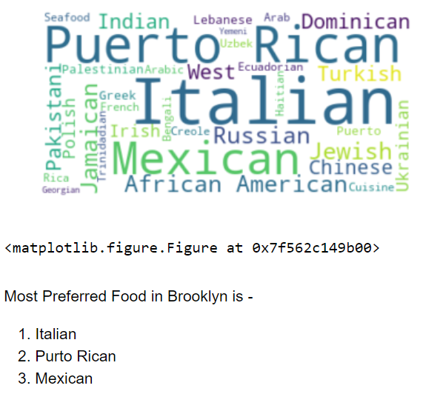
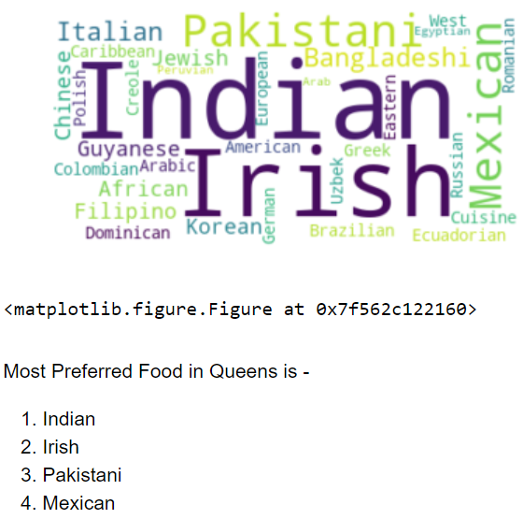
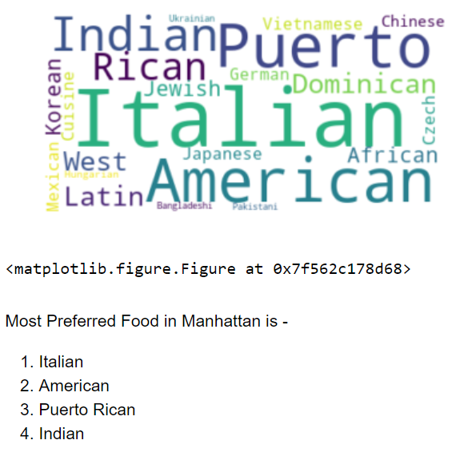
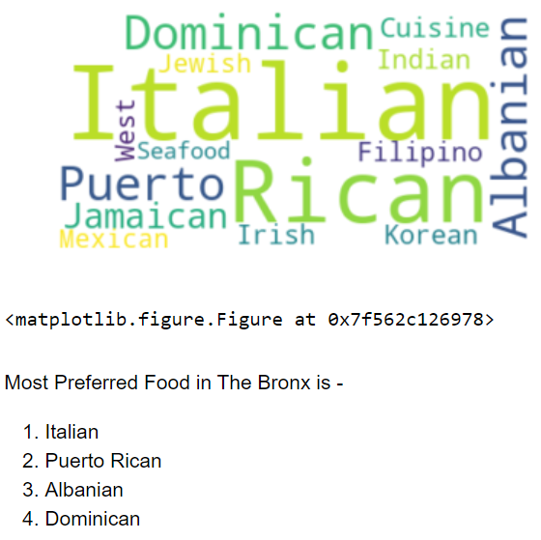
METHODOLOGY – CUISINES OF NEW YORK CITY
Most Preferred Food in Staten Island is -
Italian
Indian
Russian
Arab and Polish

Slide 15
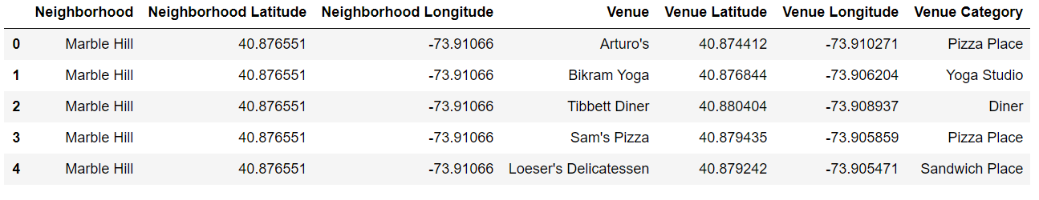
METHODOLOGY – SEGMENTING ANC CLUSTERING NEW YORK CITY
Clustering of Manhattan Brooklyn:
For the analysis, Venues have been limited to 200 and have collected nearby venues within a radius of 1000 meters.
A Total of 397 unique venue types have been sourced. Below is the snapshot of the top 5 rows of the DF

Slide 16
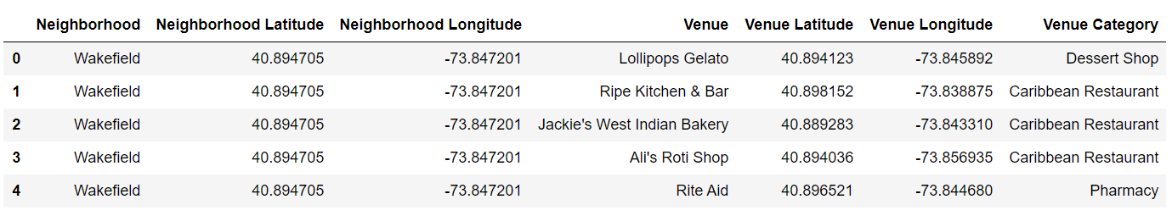
METHODOLOGY – SEGMENTING ANC CLUSTERING NEW YORK CITY
Clustering of Bronx, Queens and Staten Island:
For the analysis, Venues have been limited to 200 and have collected nearby venues within a radius of 1000 meters.
A Total of 387 unique venue types have been sourced. Below is the snapshot of the top 5 rows of the DF

Slide 17
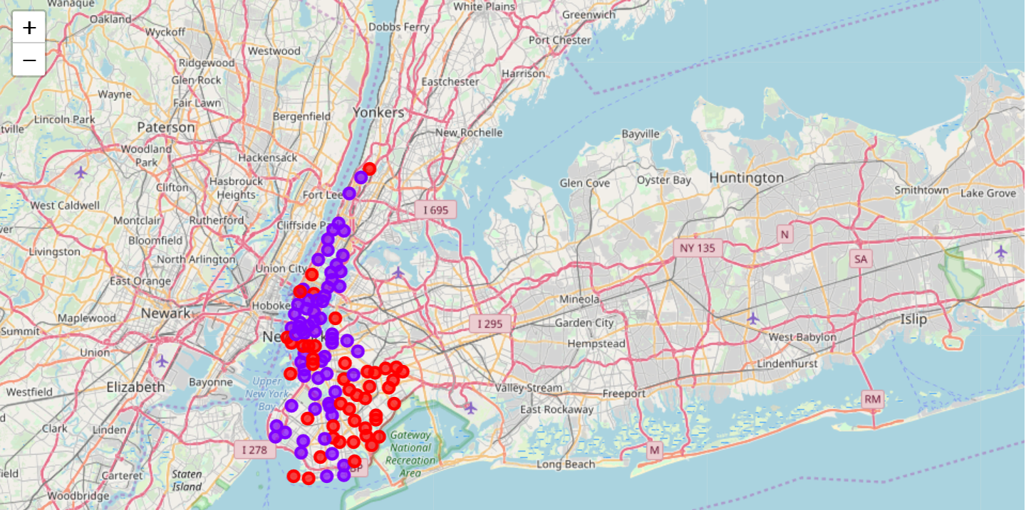
RESULTS & DISCUSSION – BROOKLYN & MANHATTAN CLUSTERING
From the Foursquare API only venues that are restaurants have been sourced for both the clusters and super imposed the venues on the Neighbourhoods.
Brooklyn and Manhattan Clustering
Based on the cluster analysis, it is identified that the Market is very saturated in both these boroughs and there aren’t any neighbourhoods that were not tapped so far. The competition is high in boroughs like Brooklyn and Manhattan with varieties of cuisines offered, a new restaurant will need to offer unique Menu in order to survive the competition. Based on the type of Cuisine that the restaurant is planning an optimal location needs to be identified taking the analysis of dataset3 into consideration.

Slide 18
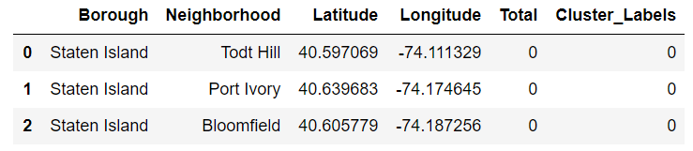
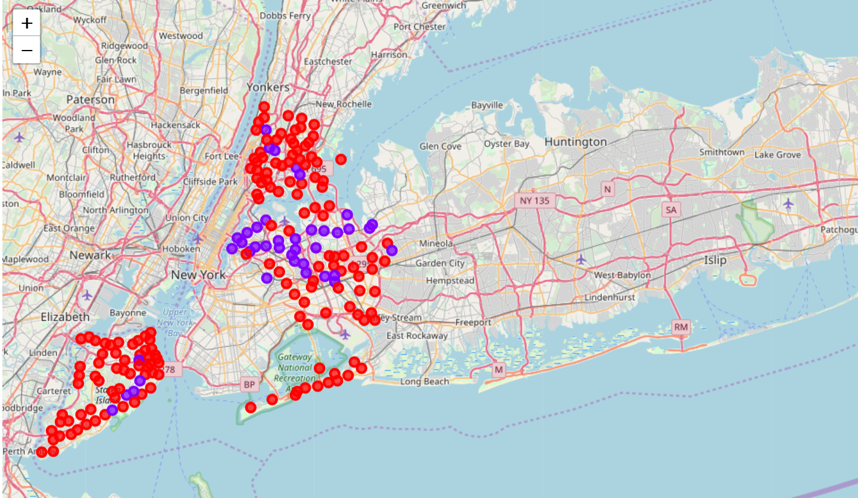
RESULTS & DISCUSSION – BRONX, QUEENS & STATEN ISLAND CLUSTERING
Based on the cluster analysis, it is identified that even though the Market of most of the neighbourhoods is saturated in these boroughs, there are still few neighbourhoods that were not tapped so far
Even though some neighbourhoods in Staten Island lack the competition, it is entirely possible that there is a very good reason for small number of restaurants in any of those neighbourhoods, reasons which would make them unsuitable for a new restaurant regardless of lack of competition in these neighbourhoods

Slide 19
CONCLUSION
The objective of this project is to identify, provide recommendation on which neighborhood of New York city will be best suitable to start a restaurant and what cuisine can be offered. Also provide the rationale behind the recommendations made. These recommendations can help company in discussion or anyone who has plans of starting a new restaurant venture in New York city
Data gathered mostly sourced from Wikipedia and also only a limited number of venues information has been sourced from Foursquare API. Clustering, segmenting and the Analysis was performed on a limited set of data.
Brooklyn and Manhattan have maximum number of restaurants, hence there might be a scope for a new restaurant if the location is carefully chosen as reason for maximum concentration may be due to huge demand for restaurant food.
Recommended Neighbourhoods should therefore be considered only as a starting point for more detailed analysis which could eventually result in location which has not only no nearby competition but also other factors taken into account and all other relevant conditions met

